Slide 1

Adventure Cycles – Profit & Sales Analysis
Presented by – Group 6
Members:
Jatin
Monica
Sanjana
Sameer
Tanuja
Vikrant

Slide 2
Project overview
Adventure Cycles wanted a better understanding of its profit and sales performance.
Our goal was to analyze sales data and build dashboards using Excel, Tableau, and Power BI to identify key trends and insights.
Contents:
1. KPIs & Insights – Key performance indicators and observations
2. Excel Dashboard – Visual representation of sales & profit in Excel
3. Tableau Dashboard – Interactive dashboard build using Tableau
4. PowerBI Dashboard – Business insights from PowerBI visuals
5. MySQL Queries & Results – Data insights extracted using MySQL queries
6. Project Summary – Key learnings and takeaways
7. Challenges Faced – Issues encountered and how we solved them.

Slide 3
KPIs & Other Insights
KPIs:
Total Sales of the company - $ 29,358,677.22 USD Total Profit of the company - $ 12,080,883.65 USD Total Production Cost - $ 17,277,793.58 USD Total Tax - $ 2,348,694.23 USD Total Freight - $ 733,969.61 USD Net Profit of the company - $ 8,998,219.81 USD (30.65% of Total Sales)
Other Insights:
1. Profit Margin by Product Color: White, Silver, and Black cycles have the highest profit margins, while Yellow and Multi-color are less profitable. The company must focus on producing more white, silver, and black cycles to increase profit.
2. Sales by Day: Tuesday is the busiest sales day, followed by Monday and Wednesday, indicating mid-week peaks in customer activity. Hence, we must advice our employees to avoid shrinkage during the first three days of the week.
3. Commute Distance Impact: Customers with shorter commute distances (e.g., 1-2 miles) generate higher average profit per order compared to those with longer commutes. For longer commutes and for orders more than $500.00, the company can feature free delivery to customer’s doorsteps.
4. Parent vs. Non-Parent Spending: Non-parents spend more per order ($90.45) compared to parents ($78.06), suggesting targeting non-parents could boost revenue.
5. Profit by Day Name: Monday has the highest profit margin among weekdays, while weekends (Saturday/Sunday) lag slightly behind.

Slide 4
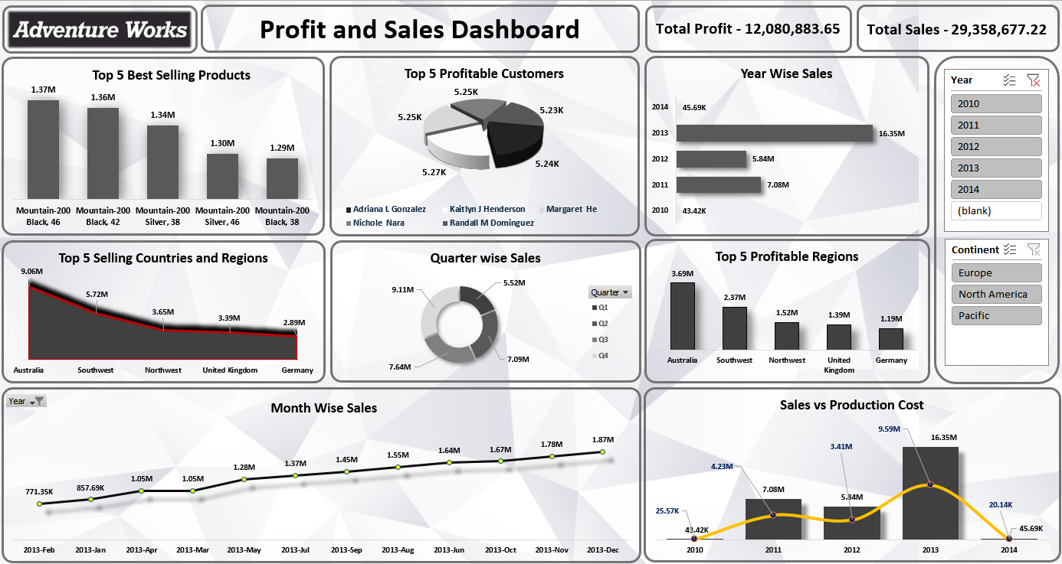







Excel Dashboard and Insights
1. Mountain Bikes Dominate: The "Mountain-200" series in Black (sizes 38, 42, 46) and Silver (38) are the top sellers, suggesting a strong preference for rugged, all-terrain bikes in neutral colors.
2. Loyal High-Spenders: Customers like Adrian L Gonzalez and Randall M Dominguez consistently drive high profits, hinting at untapped potential in personalized loyalty programs or exclusive offers.
3. Australia Outperforms: Despite being a smaller market, Australia generates higher profits than larger regions like the UK and Germany, possibly due to premium pricing & lower competition in the region.
4. Quarterly Sales Dip: Q1 sales drop significantly (e.g., $5.52M vs. $9.11M in Q4), likely due to seasonal trends—hinting at a need for targeted holiday promotions.
5. Volatile Cost-to-Sales Ratio: In 2012, production costs ($3.41M) spiked disproportionately to ($9.59M) in 2013, suggesting inefficiencies or supply chain disruptions that year—worth investigating for cost optimization.

Slide 5
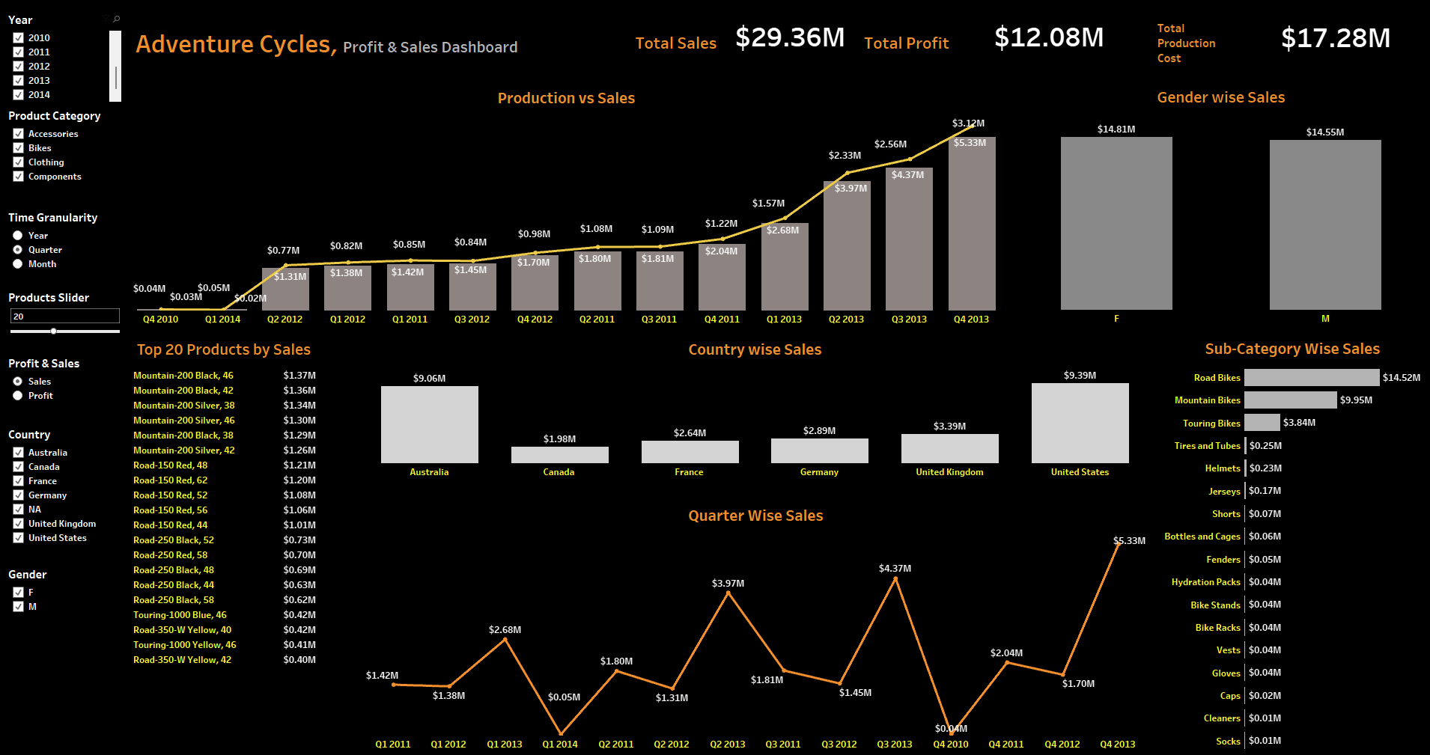
Tableau Dashboard and Insights
1. Australia alone bought more than Canada and France combined, even though the U.S. had the highest overall sales.
2. Men and women spent almost equally, showing that cycling is a shared interest regardless of gender.
3. Sales peaked in Q3 2013, then sharply dropped the next quarter, suggesting seasonality or a one-time sales push.
4. Mountain-200 Black appears thrice in the top 5 products by sales, which might mean this exact model and size is in very high demand.
5. Accessories like socks, cleaners, and caps made the least sales, hinting that customers focus more on big-ticket items like bikes rather than add-ons.

Slide 6
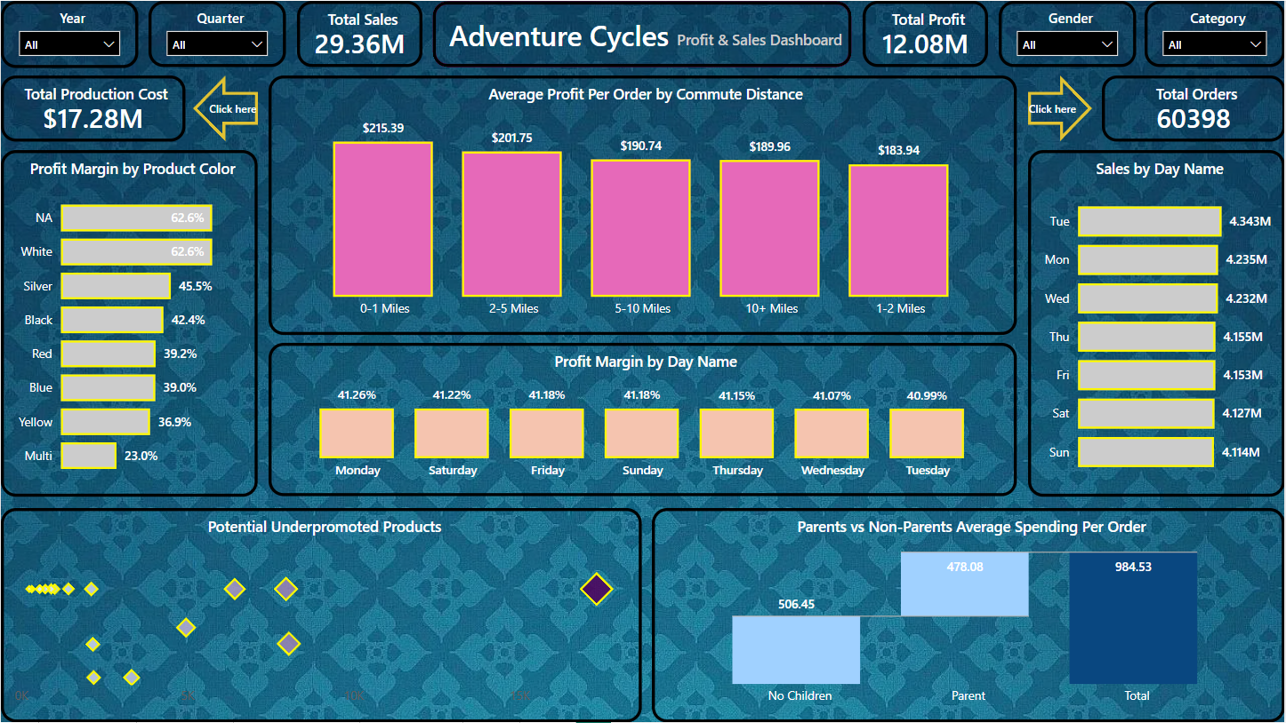
PowerBI Dashboard and Insights
1. Despite Sunday having the same profit margin as Friday and Saturday, its sales are the lowest, showing untapped potential for weekend promotions.
2. Customers commuting longer distances (10+ miles) spend nearly the same per order as those in the 5–10 mile range, suggesting distance beyond 5 miles doesn’t greatly affect spending. Providing free delivery to the customer's doorstep may boost profit.
3. Profit margins remain stable across weekdays (around 41%), but Tuesday (being the best-selling day) stands out with the lowest profit margin, hinting at possible discount-heavy campaigns.
4. White colored products lead with the highest margin (62.6%), so focusing on clean/simple designs could boost profitability.
5. Parents and non-parents have similar spending, but neither group alone matches the combined average, suggesting mixed-family orders (like group or gifting purchases) might drive larger baskets. Providing seasonal coupons would help as well.

Slide 7
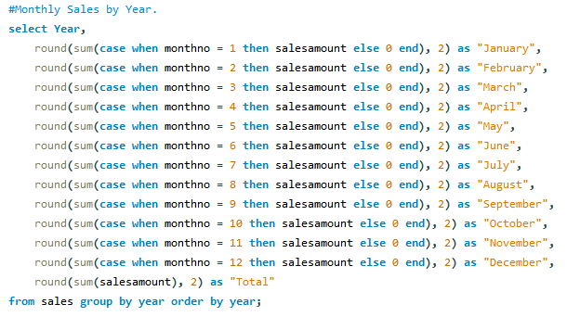
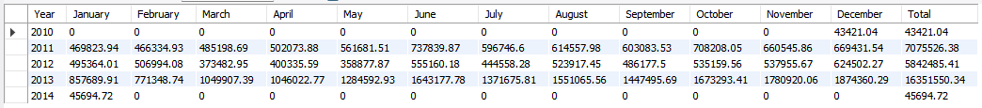
MySQL Query and Insights
1. Sales Peaked in 2013 – Focus on What Worked Insight: The year 2013 recorded the highest total sales, amounting to 17,930,206.20. 2. Consistent High Performance in November & December – Strong Q4 Insight: The months of November and December consistently show higher sales compared to other months, particularly in 2011, 2012, and 2013 (e.g., Dec 2012 = 629,450.27; Nov 2011 = 660,945.86). 3. Low Sales in Q1 (January to March) – Opportunity to Boost Engagement Insight: The first quarter (Jan–Mar) reflects lower sales across all years, indicating a weak sales season. For example, Jan 2012 = 493,664.01; Feb 2012 = 506,994.08; Mar 2012 = 378,492.95. 4. Year 2014 Shows Only January Sales – Possible Data or Business Issue Insight: In 2014, only January has recorded sales (45,694.72), while all other months are blank or zero. This may indicate missing data, a reporting issue, or a business slowdown. 5. Growth Trend from 2010 to 2013 – Market Expansion Opportunity Insight: There is a clear upward trend in total sales from 2010 (43,241.04) to 2013 (17,930,206.20).

Slide 8
Key Findings and Takeaways
The "Mountain-200" series in Black (sizes 38, 42, 46) and Silver (38) are the top sellers, suggesting a strong preference for rugged, all-terrain bikes in neutral colors.
White, Silver, and Black cycles have the highest profit margins, while Yellow and Multi-color are less profitable. The company must focus on producing more white, silver, and black cycles to increase profit.
Accessories like socks, cleaners, and caps made the least sales, hinting that customers focus more on big-ticket items like bikes rather than add-ons.
Customers commuting longer distances (10+ miles) spend nearly the same per order as those in the 5 to 10-mile range, suggesting distance beyond 5 miles doesn’t greatly affect spending. Providing free delivery to the customer's doorstep may boost profit.
Consistent High Performance in November & December – Strong Q4. The months of November and December consistently show higher sales compared to other months, particularly in 2011, 2012, and 2013 (e.g., Dec 2012 = $629,450.27; Nov 2011 = $660,945.86).

Slide 9
Challenges Faced
We had one teammate drop out of the project due to personal reasons. We did not face any other challenges.

Slide 10

Thank you

